Slide 1
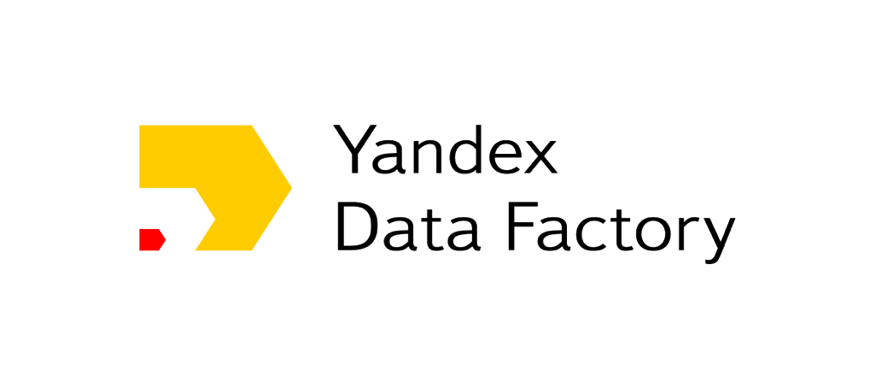
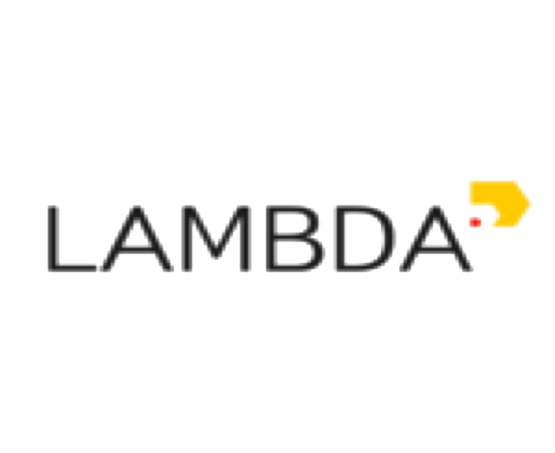
RL@Coursera week 5 Policy gradient methods

Slide 2
Small experiment
The next slide contains a question
Please respond as fast as you can!

Slide 3
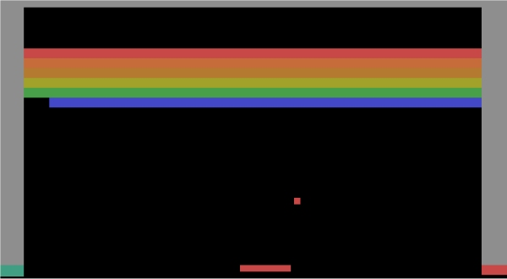
Small experiment
Left or Right?

Slide 4
Small experiment
Right! Ready for next one?

Slide 5
Small experiment
What's Q(s,right) under gamma=0.99?

Slide 6
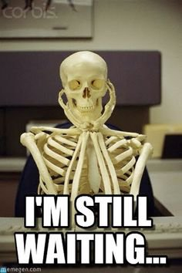
Small experiment
What's Q(s,right) under gamma=0.99?

Slide 7
Approximation error
Simple 2-state world
 | True | (A) | (B)
Q(s0,a0) | 1 | 1 | 2
Q(s0,a1) | 2 | 2 | 1
Q(s1,a0) | 3 | 3 | 3
Q(s1,a1) | 100 | 50 | 100
Trivia: Which prediction is better (A/B)?

Slide 8
Approximation error
Simple 2-state world
 | True | (A) | (B)
Q(s0,a0) | 1 | 1 | 2
Q(s0,a1) | 2 | 2 | 1
Q(s1,a0) | 3 | 3 | 3
Q(s1,a1) | 100 | 50 | 100
better policy
less MSE

Slide 9
Approximation error
Simple 2-state world
 | True | (A) | (B)
Q(s0,a0) | 1 | 1 | 2
Q(s0,a1) | 2 | 2 | 1
Q(s1,a0) | 3 | 3 | 3
Q(s1,a1) | 100 | 50 | 100
Q-learning will prefer worse policy (B)!
better policy
less MSE

Slide 10
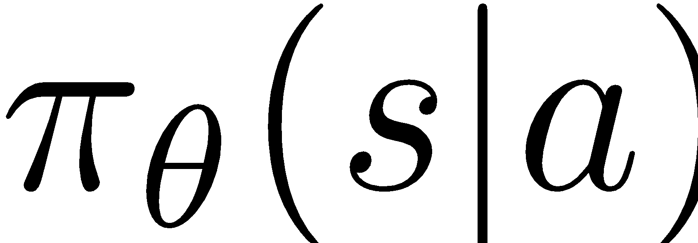
Conclusion
Often computing q-values is harder than
picking optimal actions!
We could avoid learning value functions by
directly learning agent's policy
Q: what algorithm works that way?

Slide 11
Conclusion
Often computing q-values is harder than
picking optimal actions!
We could avoid learning value functions by
directly learning agent's policy
Q: what algorithm works that way?
(of those we studied)

Slide 12
Conclusion
Often computing q-values is harder than
picking optimal actions!
We could avoid learning value functions by
directly learning agent's policy
Q: what algorithm works that way?
e.g. crossentropy method

Slide 13
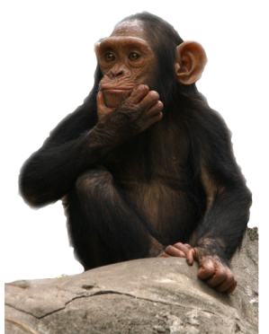

NOT how humans survived
argmax
[Q(s,pet the tiger)
Q(s,run from tiger)
Q(s,provoke tiger)
Q(s,ignore tiger)]

Slide 14
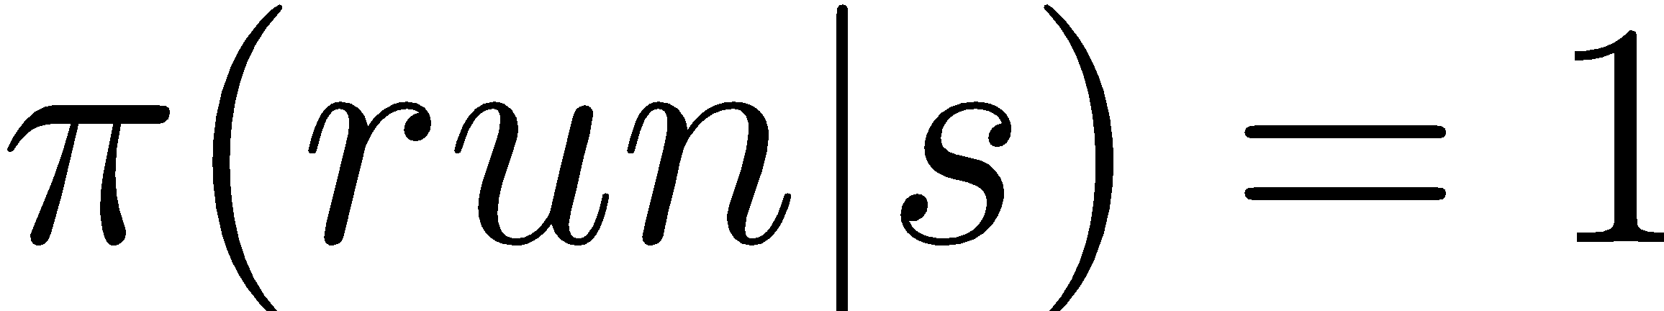
how humans survived

Slide 15
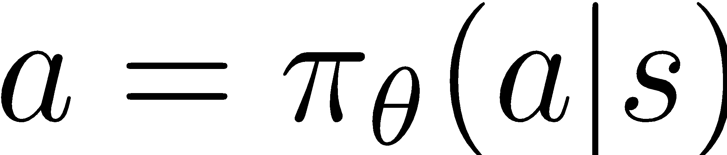
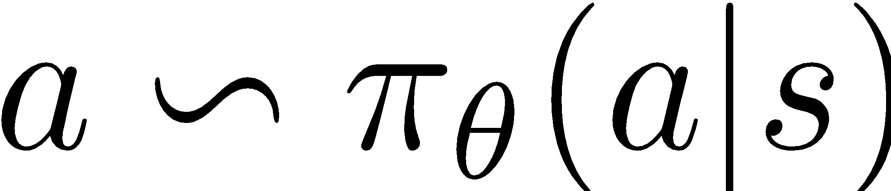
Policies
In general, two kinds
Deterministic policy
Stochastic policy

Slide 16
Policies
In general, two kinds
Deterministic policy
Stochastic policy
Q: Any case where stochastic is better?

Slide 17
Policies
In general, two kinds
Deterministic policy
Stochastic policy
e.g. rock-paper-scissors
Q: Any case where stochastic is better?

Slide 18
Policies
In general, two kinds
Deterministic policy
Stochastic policy
same action each time
sampling takes care of exploration

Slide 19
Policies
In general, two kinds
Deterministic policy
Stochastic policy
same action each time
sampling takes care of exploration
Q: how to represent policy in continuous action space?

Slide 20
Policies
In general, two kinds
Deterministic policy
Stochastic policy
same action each time
sampling takes care of exploration
categorical, normal, mixture of normal, whatever

Slide 21
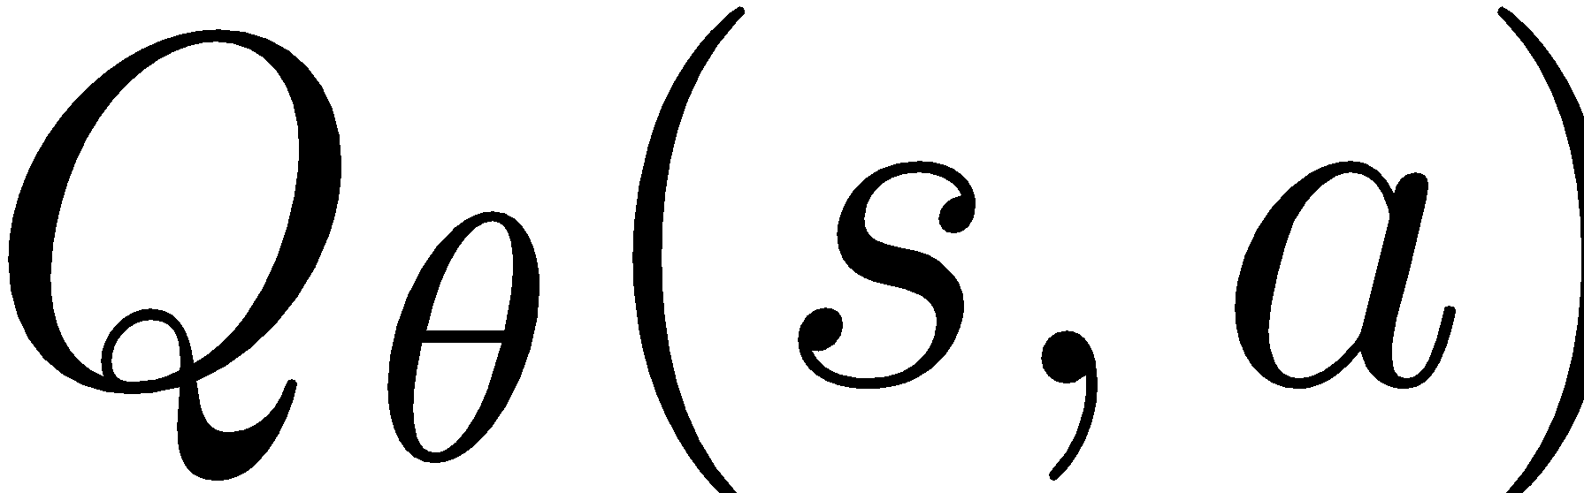
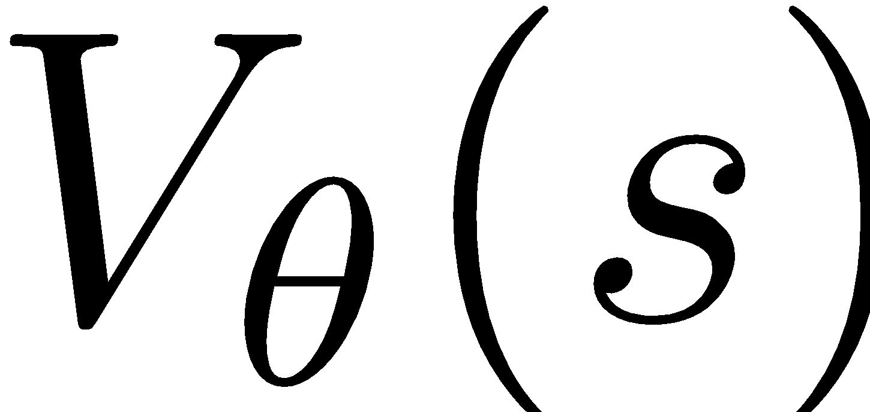
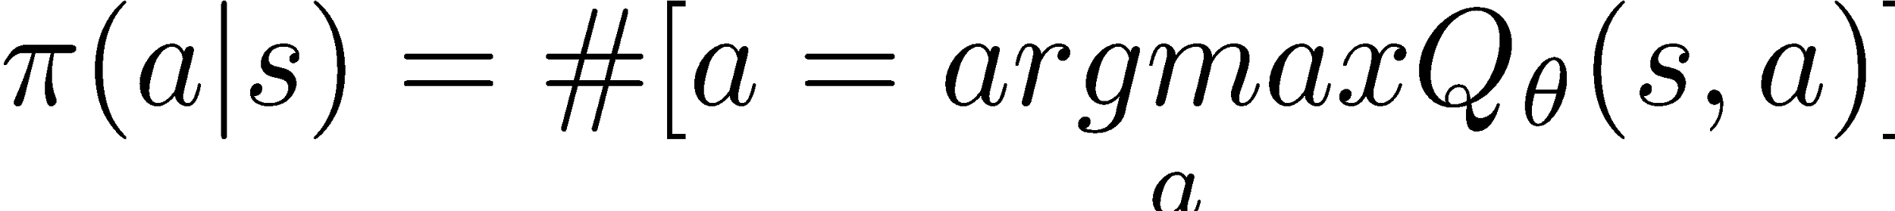
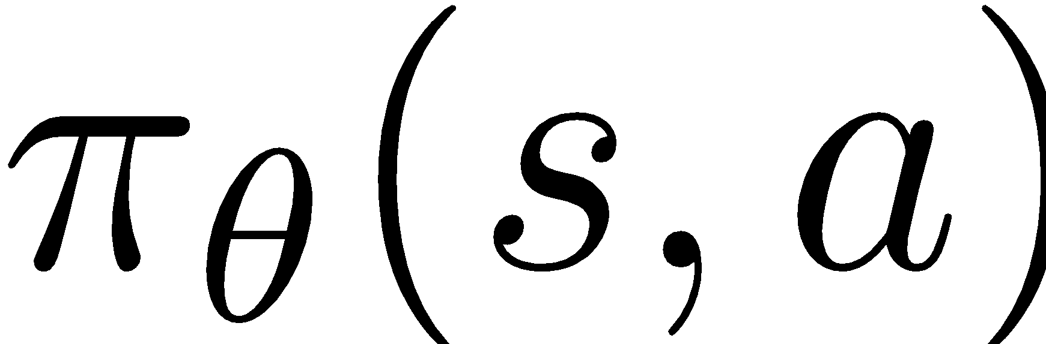
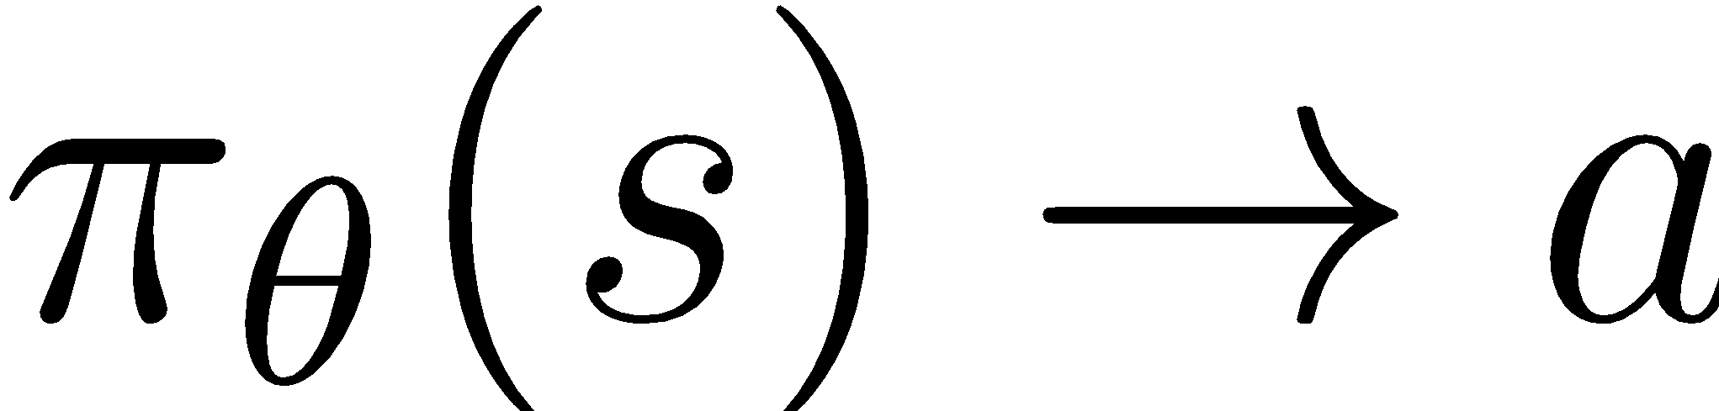
Two approaches
Value based:
Learn value function or
Infer policy
Policy based:
Explicitly learn policy or
Implicitly maximize reward over policy

Slide 22
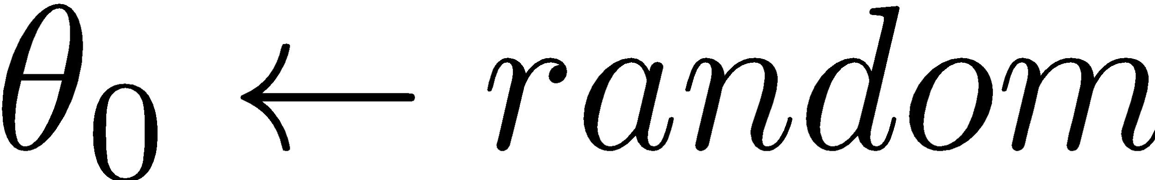
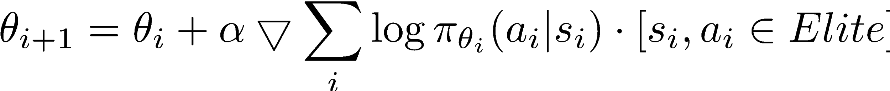
Recap: crossentropy method
Initialize policy params
Loop:
Sample N sessions
elite = take M best sessions and concatenate

Slide 23
Policy gradient main idea
Why so complicated?
We'd rather simply maximize G over pi!

Slide 24
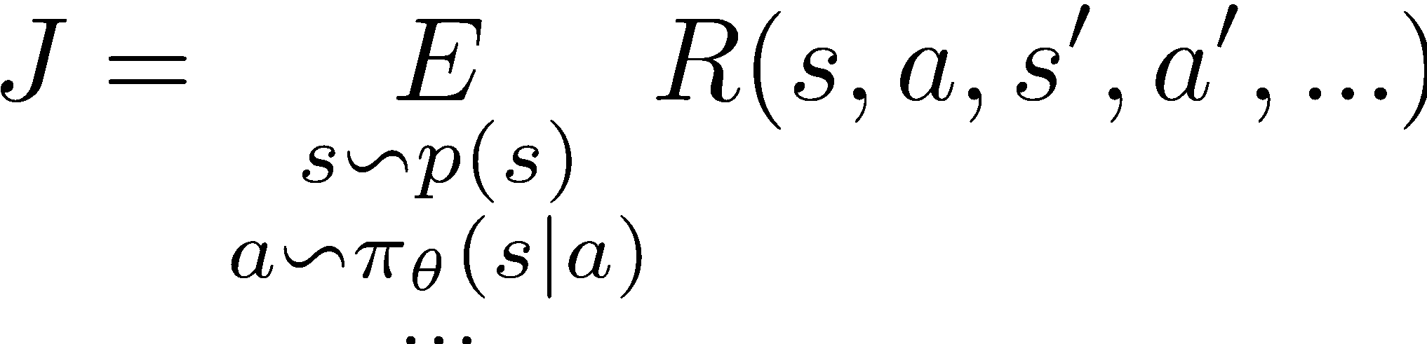
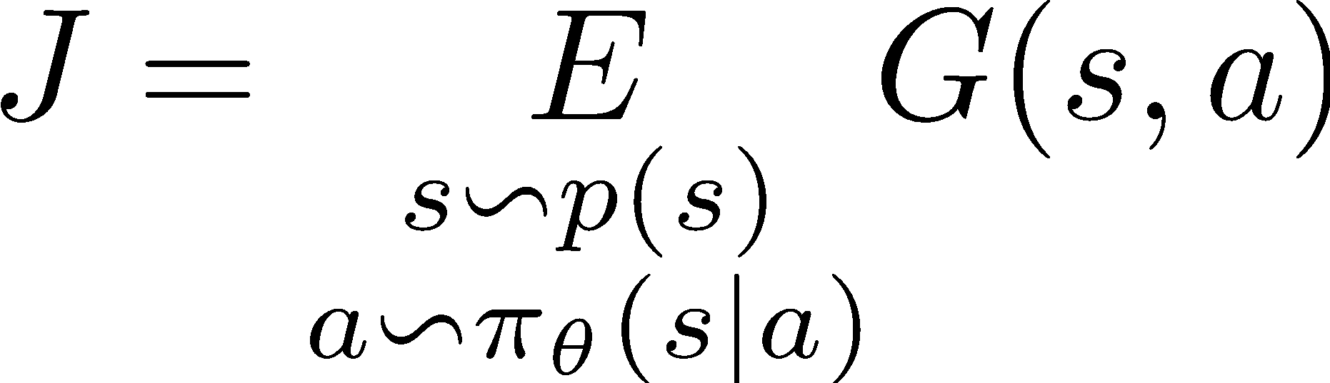
Objective
Expected reward:
Expected discounted reward:

Slide 25
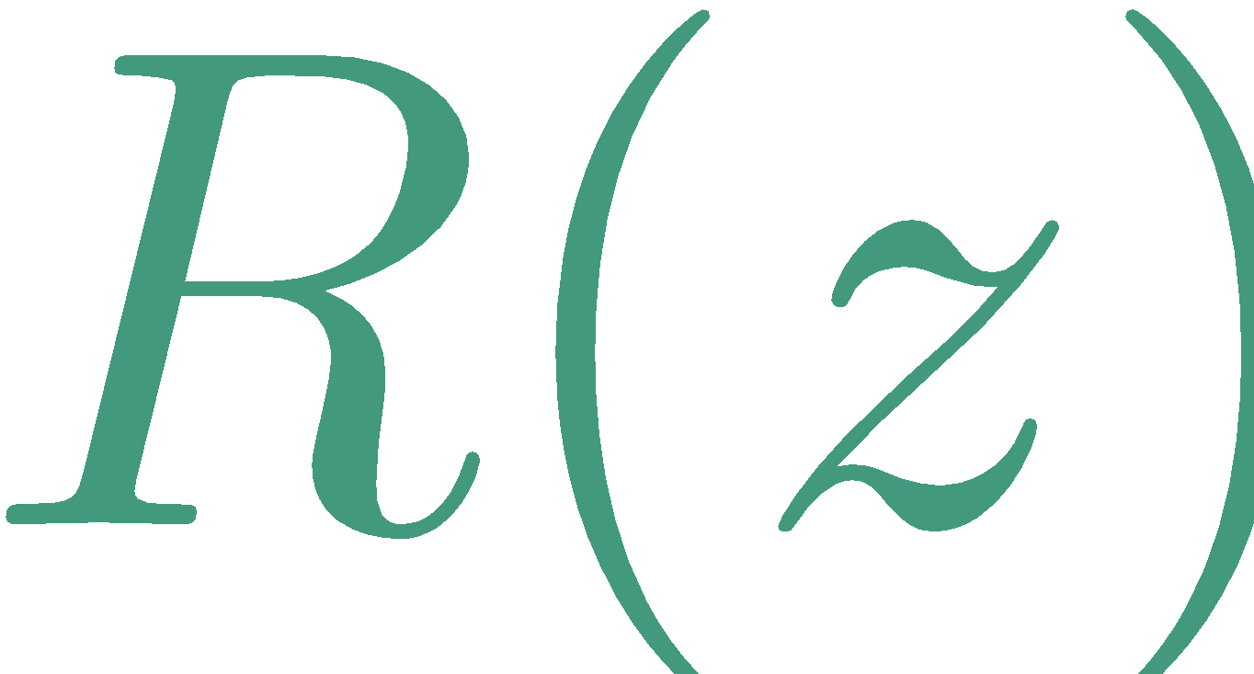
Objective
Expected reward:
Expected discounted reward:
setting

Slide 26
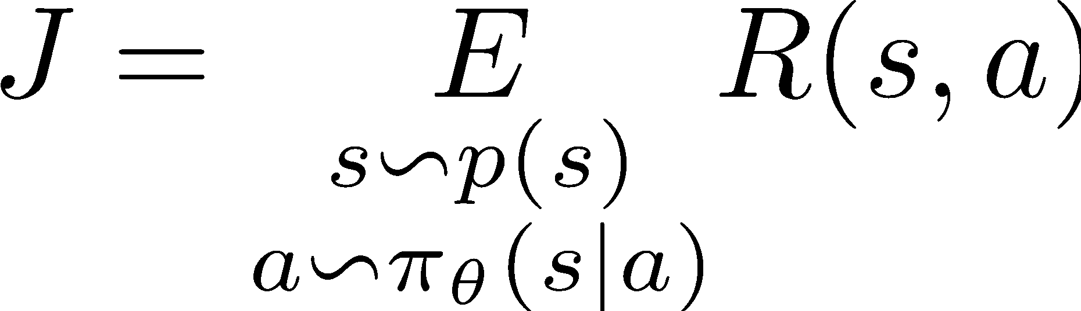
Objective
Consider an 1-step process for simplicity

Slide 27
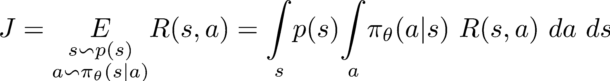
Objective
Consider an 1-step process for simplicity

Slide 28
Objective
Consider an 1-step process for simplicity
state visitation frequency
(may depend on policy)
Reward for
1-step session

Slide 29
Objective
Consider an 1-step process for simplicity
state visitation frequency
(may depend on policy)
Reward for
1-step session
Q: how do we compute that?

Slide 30
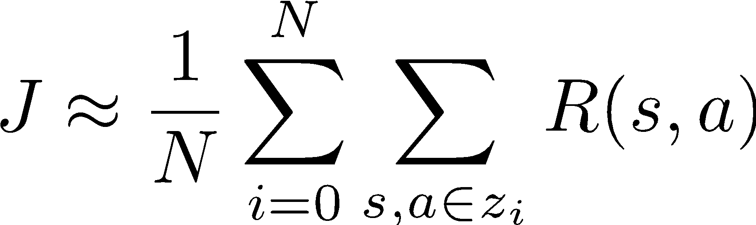
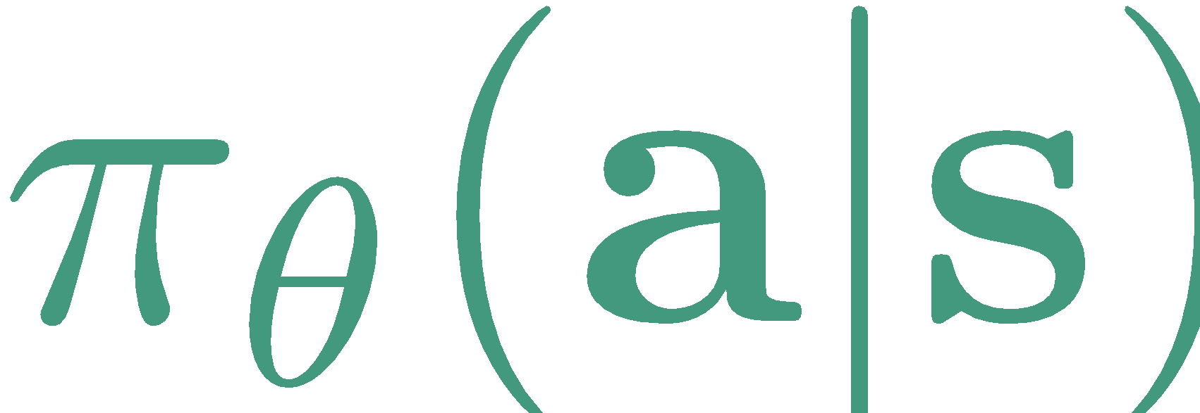
Objective
Consider an 1-step process for simplicity
Reward for agent's action
sample N sessions
by following

Slide 31
Objective
Consider an 1-step process for simplicity
Reward for agent's action
sample N sessions
Can we optimize policy now?

Slide 32
Objective
Consider an 1-step process for simplicity
parameters “sit” here
We don't know how to compute dJ/dtheta

Slide 33
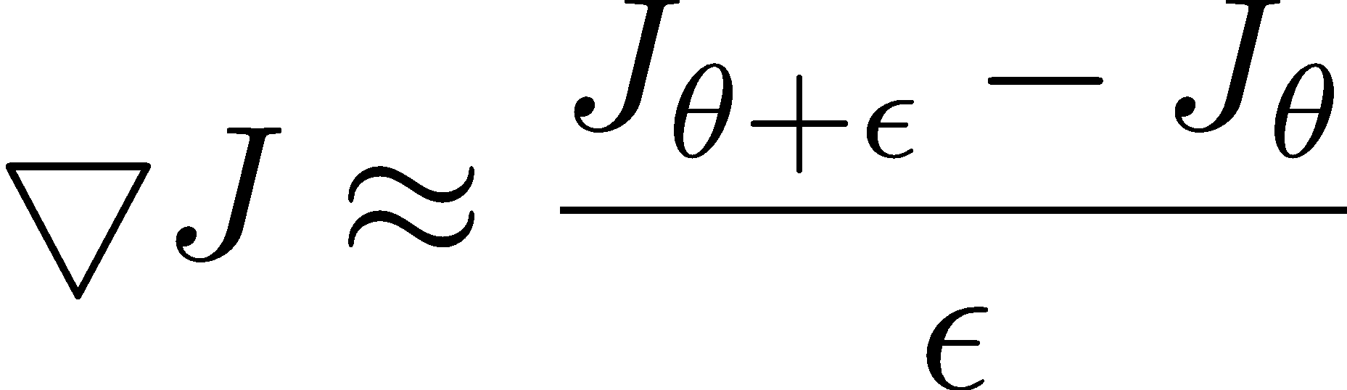
Optimization
Finite differences
Change policy a little, evaluate
Stochastic optimization
Good old crossentropy method
Maximize probability of “elite” actions

Slide 34
Optimization
Finite differences
Change policy a little, evaluate
Stochastic optimization
Good old crossentropy method
Maximize probability of “elite” actions

Slide 35
Optimization
Finite differences
Change policy a little, evaluate
Stochastic optimization
Good old crossentropy method
Maximize probability of “elite” actions
VERY noizy, especially if both Js are sampled
stochastic MDPs;
Throws a most sessions away

Slide 36
Objective
Consider an 1-step process for simplicity
Wish list:
Analytical gradient
Easy/stable approximations

Slide 37

Logderivative trick
Simple math
(try chain rule)

Slide 38
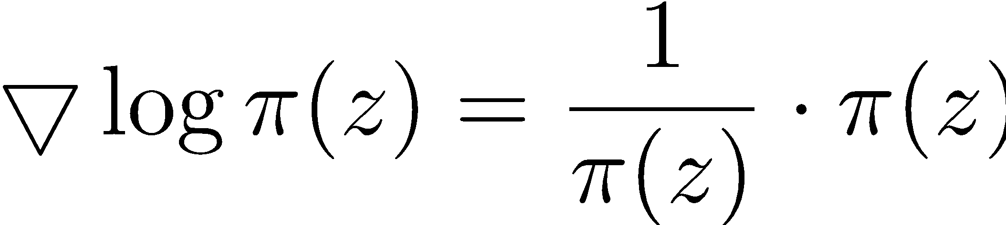
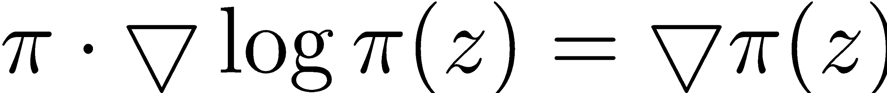
Logderivative trick
Simple math

Slide 39
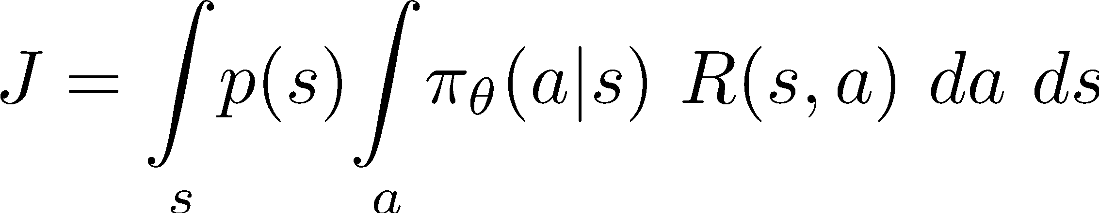
Policy gradient
Analytical inference

Slide 40
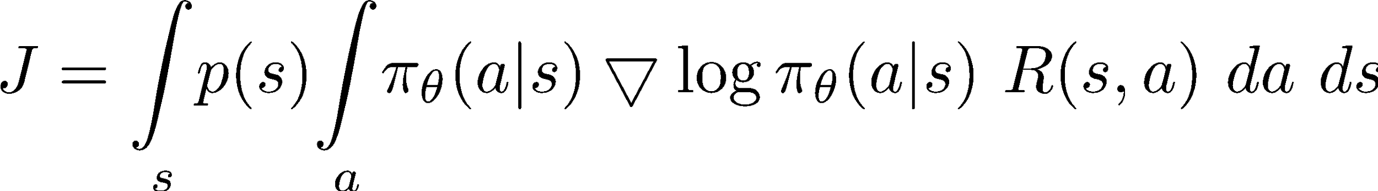
Policy gradient
Analytical inference
Trivia: Anything curious about that formula?

Slide 41
Policy gradient
Analytical inference
that's expectation :)

Slide 42
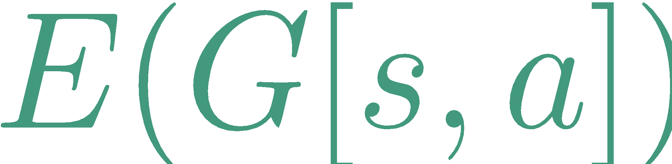
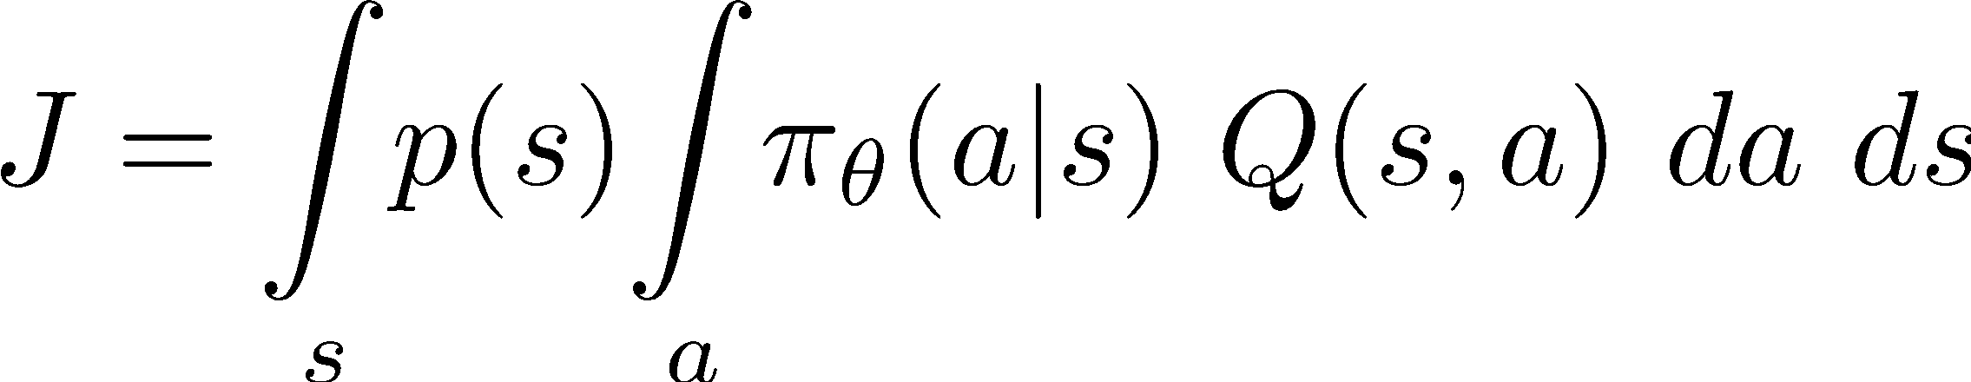
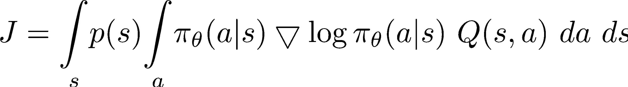
Discounted reward case
True action value
a.k.a.
Replace R with Q :)
that's expectation :)

Slide 43
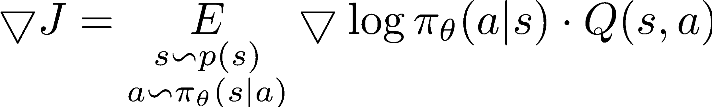
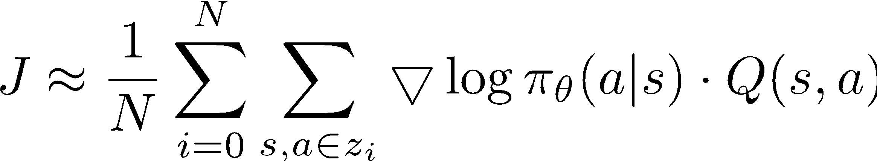
Policy gradient (REINFORCE)
Policy gradient
Approximate with sampling

Slide 44
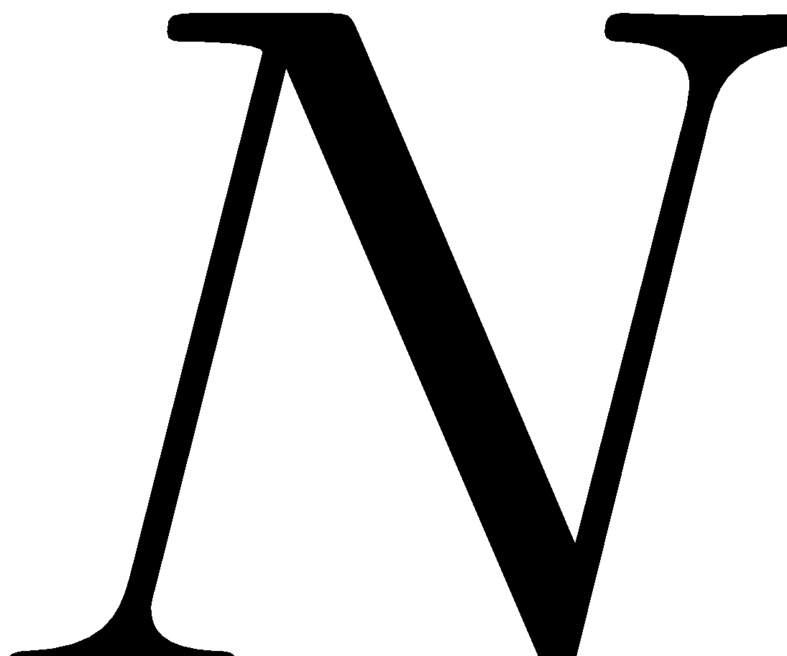
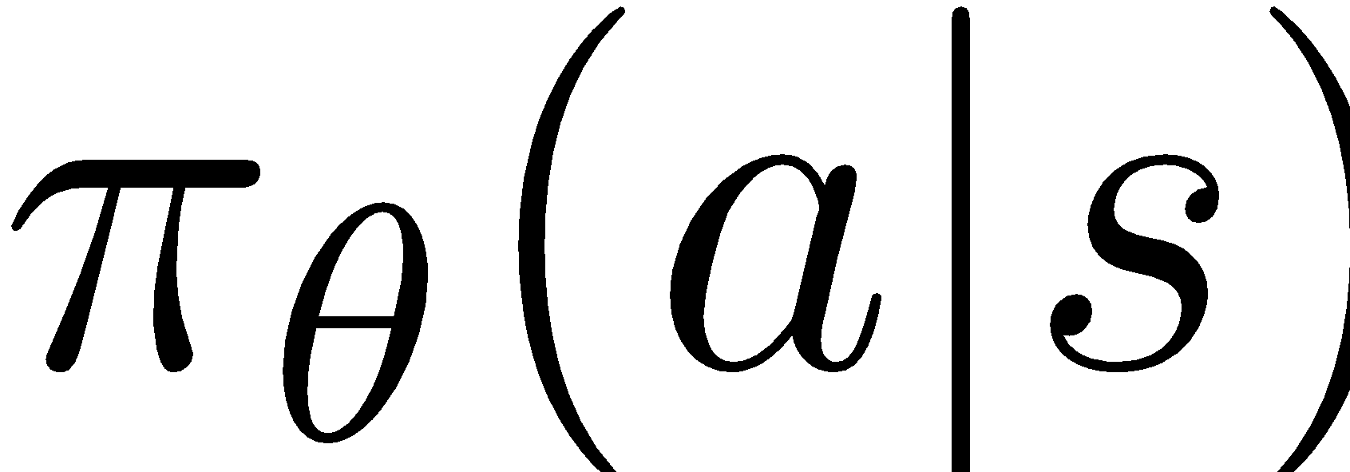
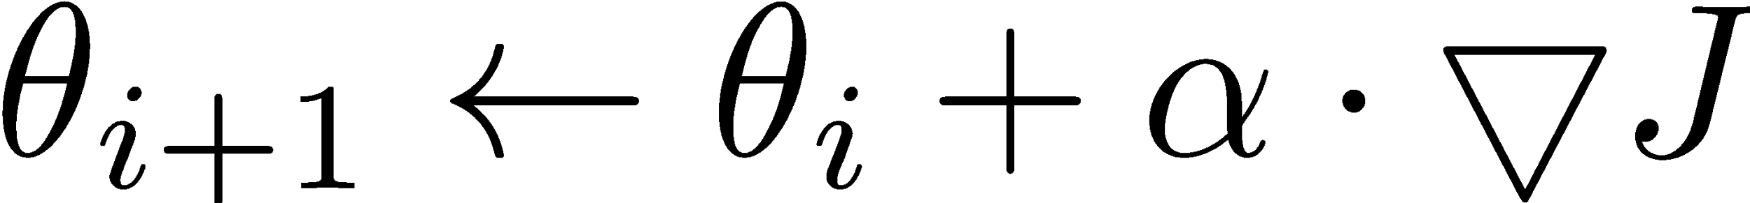
REINFORCE algorithm
Initialize NN weights
Loop:
Sample sessions z under current
Evaluate policy gradient
Ascend

Slide 45
REINFORCE algorithm
Initialize NN weights
Loop:
Sample sessions z under current
Evaluate policy gradient
Ascend
Q: is it on- or off-policy?

Slide 46
REINFORCE algorithm
Initialize NN weights
Loop:
Sample sessions z under current
Evaluate policy gradient
Ascend
actions under current policy = on-policy

Slide 47
REINFORCE algorithm
Initialize NN weights
Loop:
Sample sessions z under current
Evaluate policy gradient
Ascend
What is better for learning:
random action in good state or
great action in bad state?

Slide 48
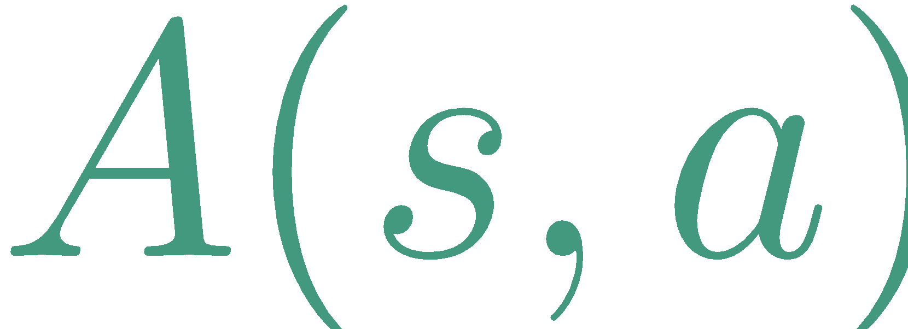
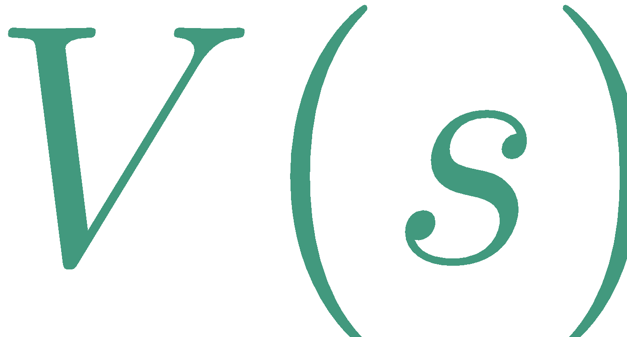
REINFORCE baseline
Initialize NN weights
Loop:
Sample sessions z under current
Evaluate policy gradient
Ascend
Actions influence only, so is irrelevant

Slide 49
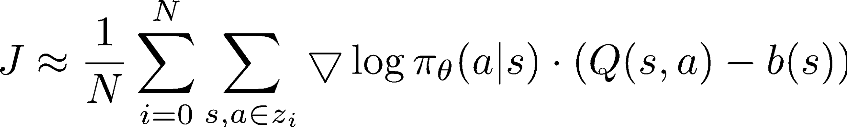
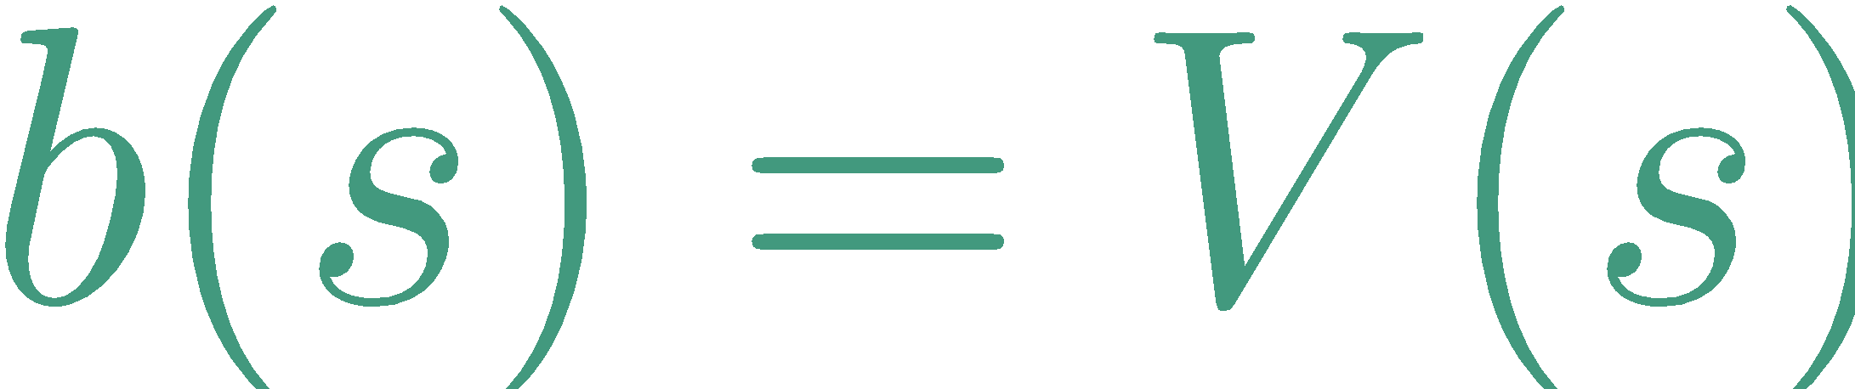
REINFORCE baseline
Initialize NN weights
Loop:
Sample sessions z under current
Evaluate policy gradient
Ascend
Anything that doesn't depend on action
ideally,

Slide 50
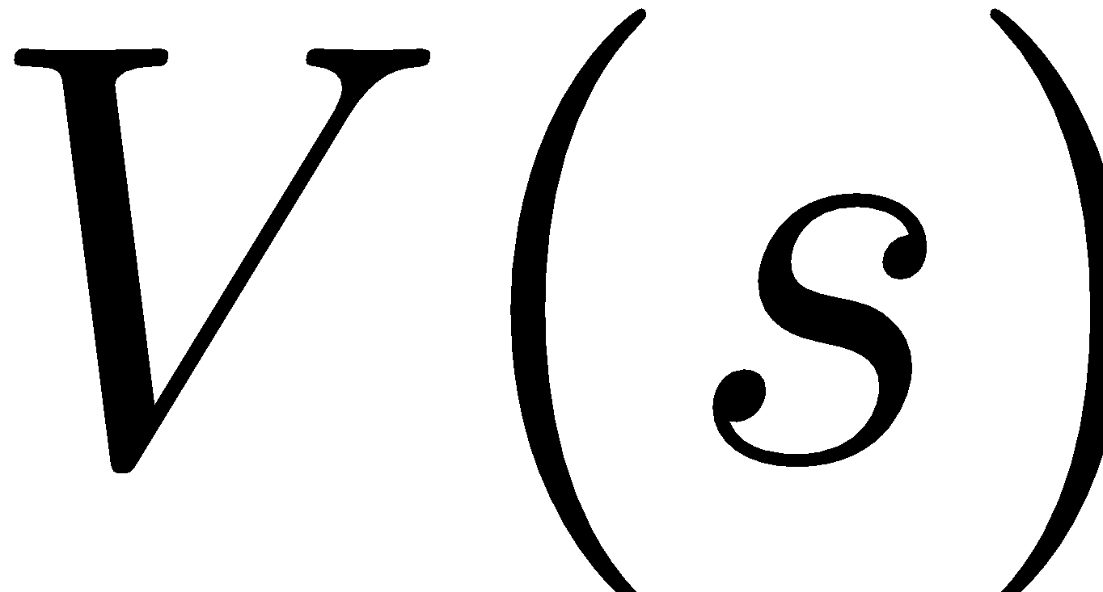

Actor-critic
Learn both and
Hope for best of both worlds :)
image: youtube: mr tivikov

Slide 51
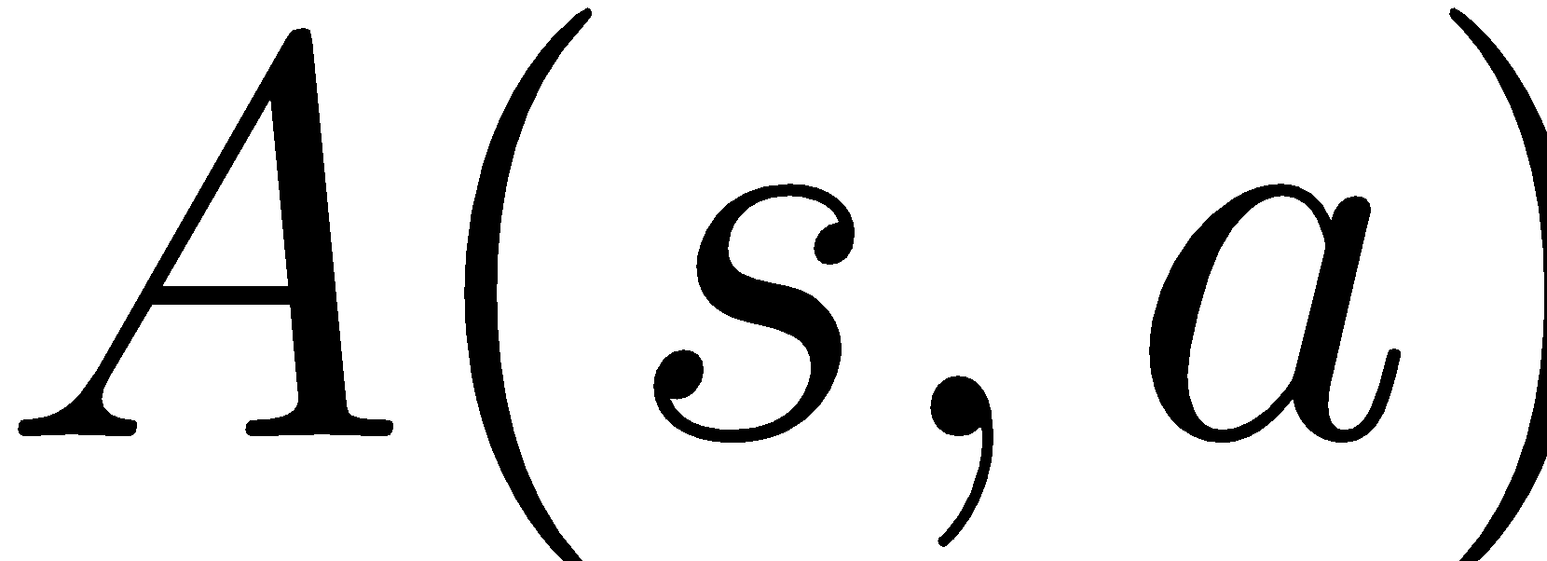
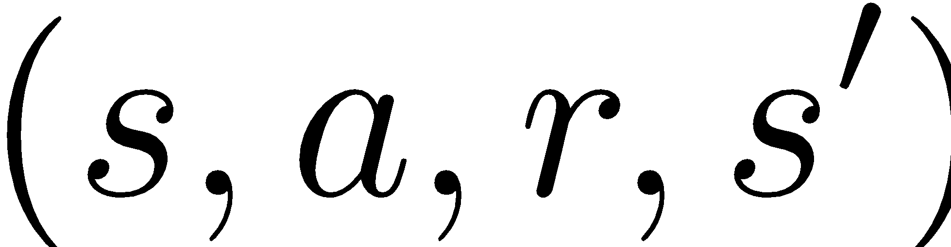
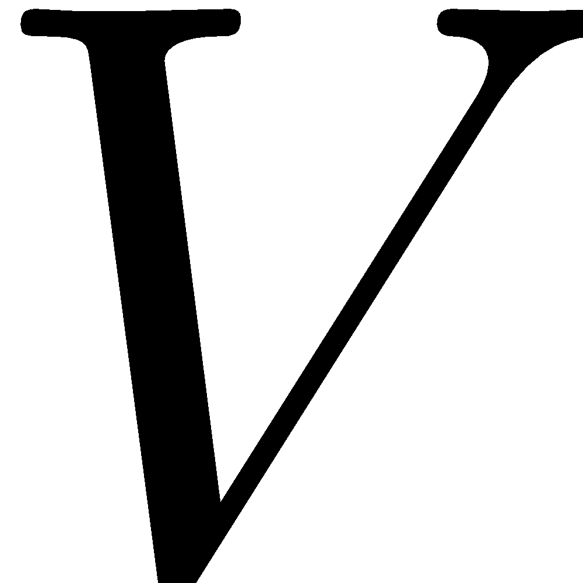
Advantage actor-critic
Idea: learn both and
Use to learn faster!
Non-trivia: how can we estimate from and - function?

Slide 52
Advantage actor-critic
Idea: learn both and
Use to learn faster!
Non-trivia: how can we estimate from and - function?

Slide 53
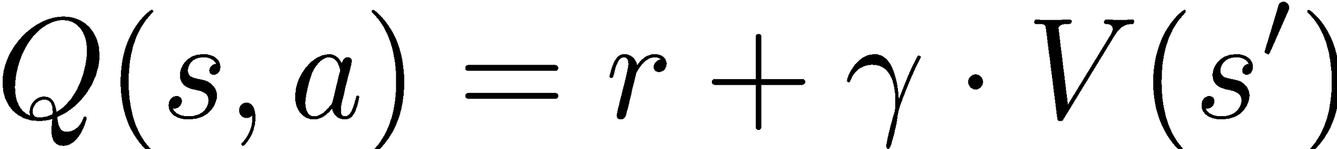
Advantage actor-critic
Idea: learn both and
Use to learn faster!

Slide 54
Advantage actor-critic
Idea: learn both and
Use to learn faster!
Also: n-step version

Slide 55
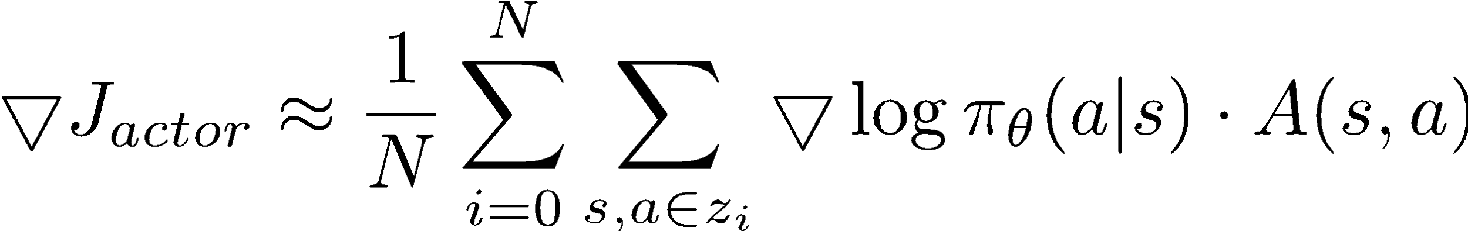
Advantage actor-critic
Idea: learn both and
Use to learn faster!
consider
const
Trivia: How do we train V then?

Slide 56
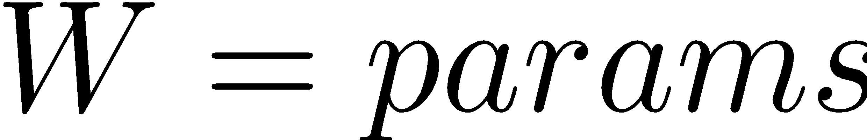
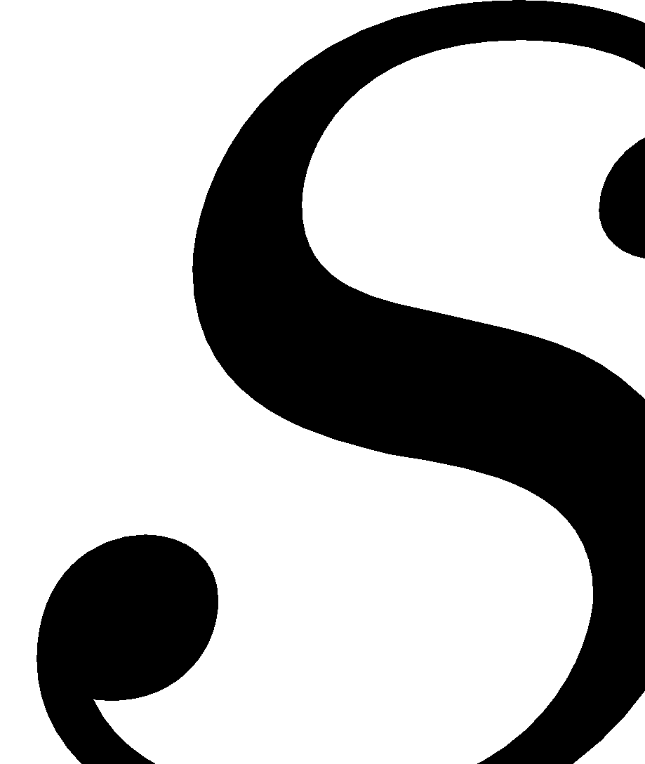
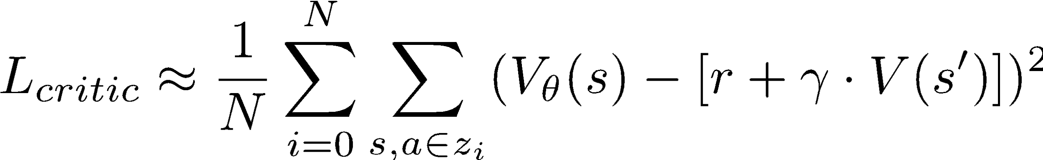
Advantage actor-critic
model
state

Slide 57
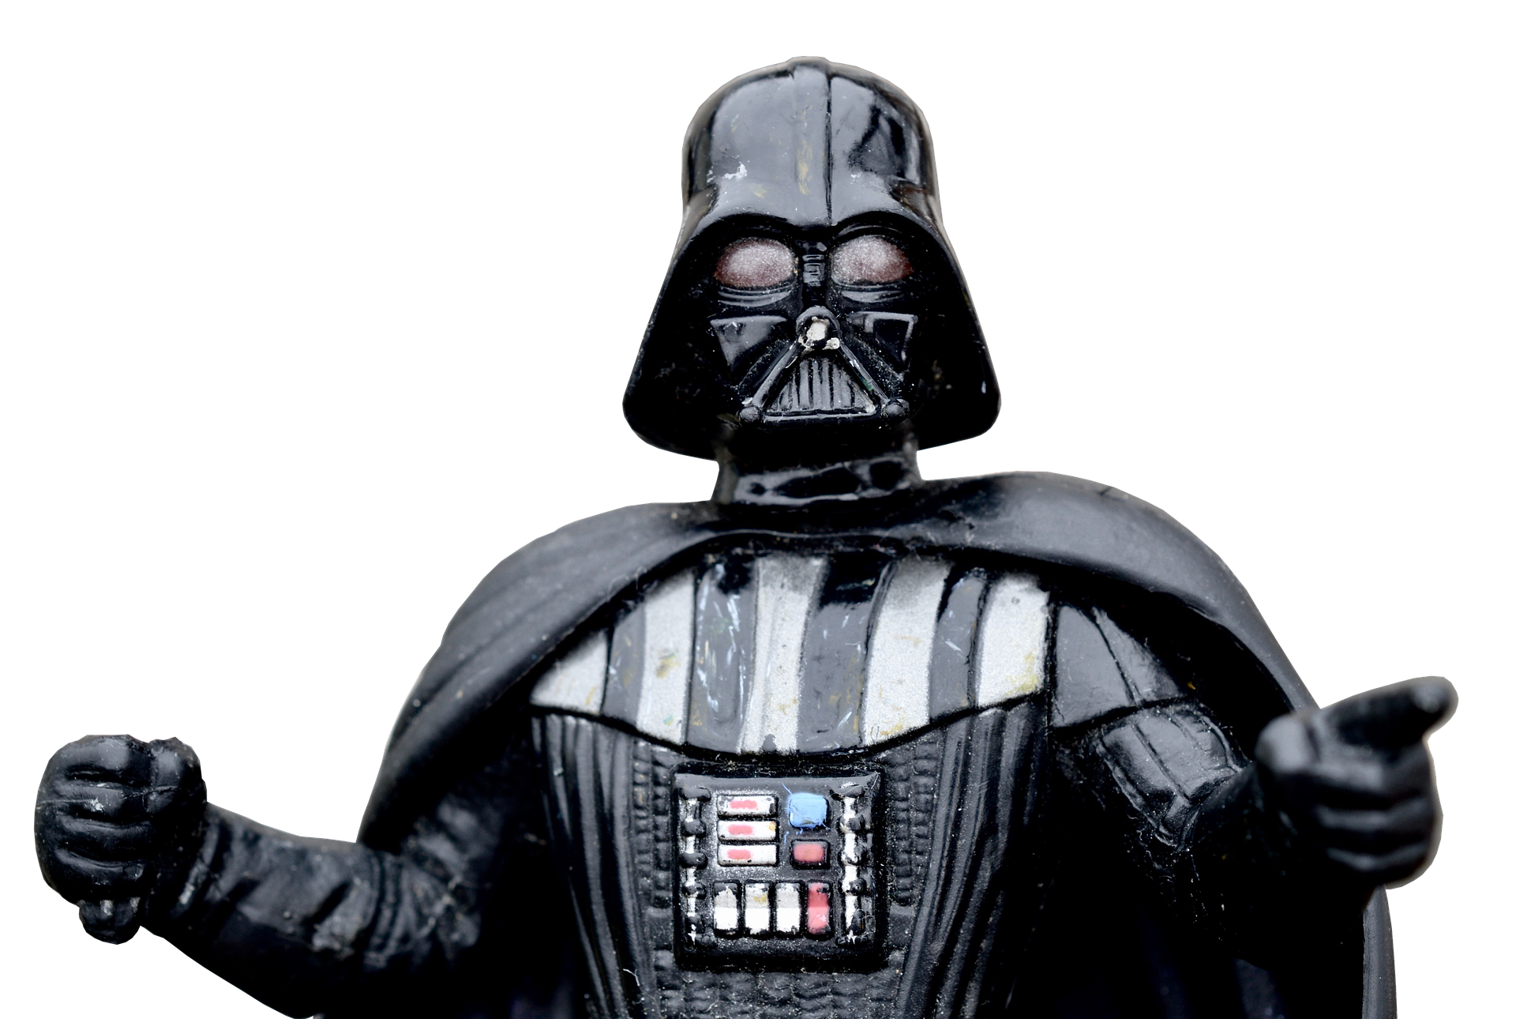
value-based Vs policy-based
Value-based | Policy-based + Actor-critic
Q-learning, SARSA,value-iteration | REINFORCE, Advantage Actor-Critic, Crossentropy Method

Slide 58
value-based Vs policy-based
Value-based | Policy-based + Actor-critic
Q-learning, SARSA,value-iteration | REINFORCE, Advantage Actor-Critic, Crossentropy Method
Your guess?

Slide 59

Casy Study: A3C
A popular implementation
of advantage actor-critic
using neural net agent
No experience replay
Many parallel sessions
Asynchronous updates
image: http://bit.ly/2z0kBNu

Slide 60


Casy Study: A3C results

Slide 61

Duct tape zone
V(s) errors less important than in Q-learning
actor still learns even if critic is random, just slower
Regularize with entropy
to prevent premature convergence
Learn on parallel sessions
Or super-small experience replay
Use logsoftmax for numerical stability

Slide 62
value-based Vs policy-based
Value-based | Policy-based + Actor-critic
Q-learning, SARSA, value-iteration | REINFORCE, Advantage Actor-Critic, Crossentropy Method
Solves harder problem | Solves easier problem
Explicit exploration | Innate exploration & stochasticity
Evaluates states & actions | Easier for for continuous actions
Easier to train off-policy | Compatible with supervised learning

Slide 63
Supervised pre-training
Reinforcement learning usually takes longto find
optimal policy completely from scratch.
We can use existing knowledge to help it!
Human experience
Known heuristic
Previous system

Slide 64


Supervised pre-training
Supervised learning:
Policy gradient:

Slide 65

Supervised pre-training
Supervised learning:
Policy gradient:

Slide 66

Supervised pre-training
Supervised learning:
Policy gradient:
Q: what's different? (apart from )

Slide 67
Supervised pre-training
Supervised learning:
Policy gradient:
reference
generated

Slide 68
More out there
This domain is huge!
Trust Region Policy optimization
policy gradient on steroids
Deterministic policy gradients
Off-policy & less variance
Many many more!
Research happens as you read this line

Slide 69
Let's code!

